Slide 1




CONTRACEPTION
University of Basrah
Al-Zahraa Medical College
Ministry of higher Education and Scientific Research
University of Basrah
Al-Zahraa Medical College
Academic year 2025-2026
5th year
REPRODUCTIVE BLOCK
Lecture: 2
Duration : 1 hour
Presented by
Dr.Marwa sadiq
Block staff:
Dr.Marwa Sadik
Dr. Safa keffah
Dr.Hawraa maitham
GYNAECOLOGY 20th
EDITION by Ten Teachers

Slide 2
OBJECTIVES
University of Basrah
Al-Zahraa Medical College
Ministry of higher Education and Scientific Research
describe the main methods of contraception and their advantages and disadvantages .

Slide 3
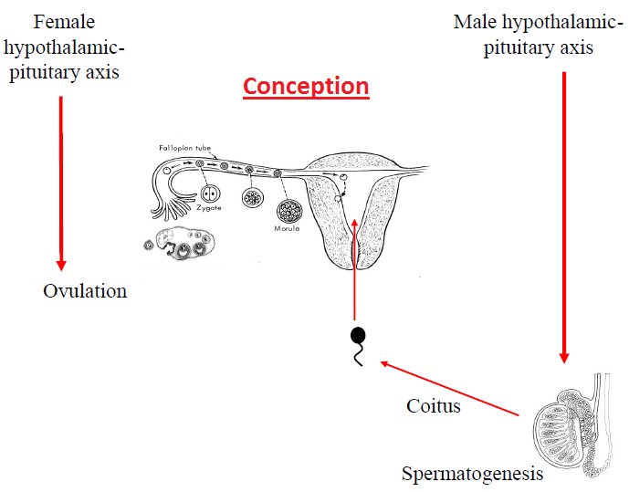
University of Basrah
Al-Zahraa Medical College
Ministry of higher Education and Scientific Research
Contraception or “Family planning “
generally refers to those birth control measures that allow people to postpond or prevent conception.

Slide 4
University of Basrah
Al-Zahraa Medical College
Ministry of higher Education and Scientific Research
BENEFITS
personal reasons. Many couples use contraception FOR :-
to space their children
to limit their family size
Others desire to avoid childbearing because of the effects of preexisting illness on the pregnancy, such as severe diabetes or heart disease.

Slide 5

University of Basrah
Al-Zahraa Medical College
Ministry of higher Education and Scientific Research
As a matter of public policy some countries promote contraception in an effort to curb undesired population growth

Slide 6
University of Basrah
Al-Zahraa Medical College
Ministry of higher Education and Scientific Research
The characteristics of the ideal contraceptive method would be:
highly effective
no side effects or risks
cheap
independent of intercourse
non-contraceptive benefits
acceptable to all cultures and religions

Slide 7
Classification of contraception according to mechanism
University of Basrah
Al-Zahraa Medical College
Ministry of higher Education and Scientific Research
1-natural.
2-barrier
3-prevention of ovulation
4-inhibition of sperm transport
5-inhibition of implantation.

Slide 8
‘Natural’ Contraception
University of Basrah
Al-Zahraa Medical College
Ministry of higher Education and Scientific Research
1. Abstinance ‘Safe period’
prevent sperms to reach the female genital tract around time of ovulation (fertile period).
Calculation of fertile period?Shortest cycle-20
Longest cycle-10
2. Coitus interrupts ‘ withdrawal’
the penis withdraws from the vagina immediately before ejaculation takes place.
Disadvantage :- high failure rate.
3. The lactational amenorrhoea method (LAM)
used by fully breastfeeding mothers during
the first six months of infant life.

Slide 9
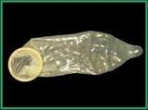
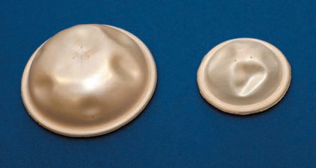
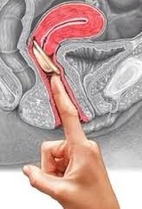
  Barrier Methods
1. Condoms
  For male
2. Diaphragm
  inserted into the vagina between the
  post-fornix and the symphysis pubis.
  Needs correct fitting .
  Holds sperm in the acidic environment
  of vagina and reduces survival time
  Does not completely occlude the
  passage of sperm .
3. Cap :- Fits across the cervix .
4. Spermicides:- gel or pessaries .
1
2
3

Slide 10
University of Basrah
Al-Zahraa Medical College
Ministry of higher Education and Scientific Research
Spermicides are non-hormonal chemical products containing the active ingredient nonoxynol-9 (N-9) or octoxynol-9 (0-9).
They can be used in combination with other barrier contraceptives such as condoms, cervical caps, or diaphragms.

Slide 11
University of Basrah
Al-Zahraa Medical College
Ministry of higher Education and Scientific Research
Advantages:
-protect against STIs .
- Safe .
- Cost effective .
Disadvantage of barrier methods
- high failure rate .
- need cooperative couple .

Slide 12
Hormonal Contraception
University of Basrah
Al-Zahraa Medical College
Ministry of higher Education and Scientific Research
A - Progesterone
-Small dose (e.g. mini-pills)
It is taken daily without a break
The main action :-
Thick, ‘hostile’ cervical mucus plug
Atrophic endometrium (prevent implantation)
-Large dose { e.g.Depoprovera, cerrazette , Subdemal implants (implanon) }
The main action :- inhibition of ovulation .

Slide 13
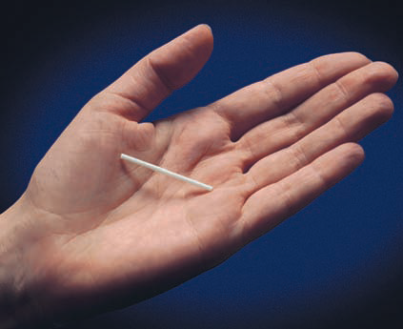
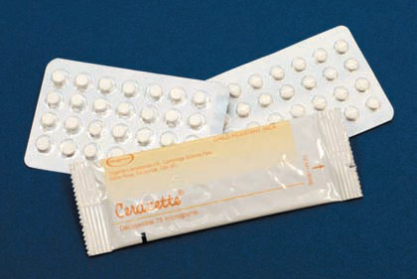
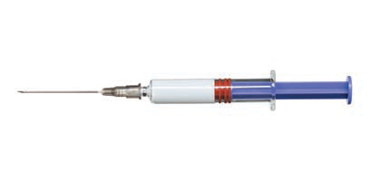
University of Basrah
Al-Zahraa Medical College
Ministry of higher Education and Scientific Research
B – Oestrogen
inhibition of ovulation

Slide 14
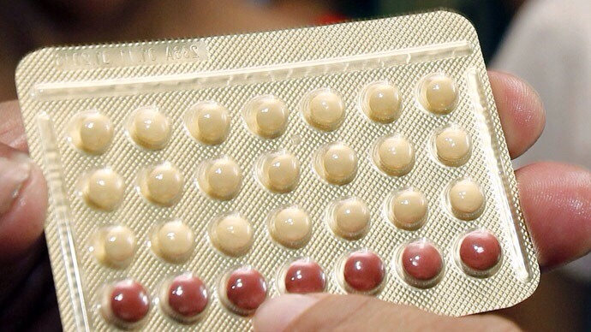
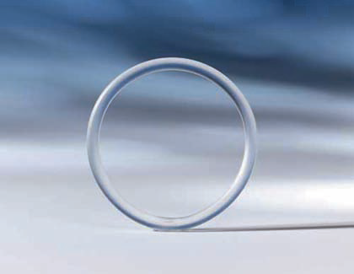
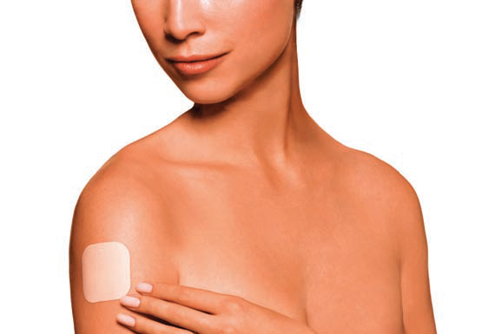
University of Basrah
Al-Zahraa Medical College
Ministry of higher Education and Scientific Research
C - Combined hormonal contraception (Progesterone and Oestrogen)
Used for 21 days and stopped for 7 days .
a-COC pills b-rings c -patches

Slide 15
A- Minor side effects
University of Basrah
Al-Zahraa Medical College
Ministry of higher Education and Scientific Research
CNS : depression, headache, loss of libido.
GIT : nausea and vomiting, weight gain, gall stones .
Breast : mastalgia, breast enlargement.
Reproductive: disturbance of menstrual cycle & increased vaginal discharge .
Others : chloasma , fluid retention .

Slide 16
B-Major side effects
University of Basrah
Al-Zahraa Medical College
Ministry of higher Education and Scientific Research
1. Venous thromboembolism (VTE):
2. Arterial disease:
less common but more serious than VTE, especially in hypertensive & smoker.
a) increase risk of MI.
b) increase risk of ischemic and hemorrhagic stroke

Slide 17
University of Basrah
Al-Zahraa Medical College
Ministry of higher Education and Scientific Research
Contraindications to COC
Absolute contraindications
• Circulatory diseases:
- ischemic heart disease
- cerebrovascular accident
- significant hypertension
- arterial or venous thrombosis
- any acquired or inherited pro-thrombotic tendency
- any Significant risk factors for cardiovascular disease
• Acute or severe liver disease
• Estrogen-dependent neoplasms, particularly breast cancer
• Focal migraine
smoking >15cigarette/day and age>35

Slide 18
University of Basrah
Al-Zahraa Medical College
Ministry of higher Education and Scientific Research
Interaction with other drugs
This can occur with liver enzyme inducing agents such as some antiepileptic drugs, sulphonamide, rifampicin (reduce efficiency).
Some antibiotics alter intestinal absorption of COC and reduce efficiency.

Slide 19
Intrauterine Contraceptive Device (IUD)
University of Basrah
Al-Zahraa Medical College
Ministry of higher Education and Scientific Research
Types:
Copper-IUD
Progesterone IUD (mirena)
Mechanism of action
1) Stimulate inflammatory reaction in the uterus which prevent implantation.
2) Copper IUDs have toxic effect on sperm that prevent sperm transport and fertilization .
3) Hormonal IUDs have local hormone effect on
the cervical mucus and endometrium

Slide 20
University of Basrah
Al-Zahraa Medical College
Ministry of higher Education and Scientific Research
Complications:
1. Menstrual disturbance : the effect of copper-IUD on the local prostaglandin in the endometrium tends to cause heavy menstrual bleeding and dysmenorrhea , while mirena will reduce menstrual blood flow.
2. Perforation (usually occur at time of insertion).
3. Expulsion
4. Ectopic pregnancy
5. Infection (usually at time of insertion)
6. Pregnancy .

Slide 21
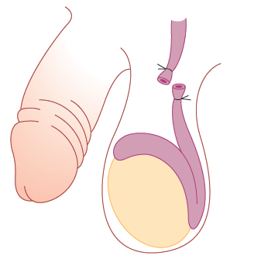
Permanent sterilization
University of Basrah
Al-Zahraa Medical College
Ministry of higher Education and Scientific Research
  Written Consent (permanent, very occasionally may fail)
1.Vasectomy(male sterilization)
- Divide vas deferens bilaterally so the sperm can not reach the ejaculate .
-Check semen few months later
Complications : -
Failure
Hematoma
Infection .
Pain

Slide 22
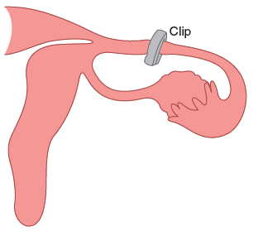

2. Tubal ligation
University of Basrah
Al-Zahraa Medical College
Ministry of higher Education and Scientific Research
- Permanent bilateral tubal blockage using ( clips, rings, ligation or diathermy ) .
- Performed by
Laprotomy .
Laparoscopy .
Hysteroscopy ( Essure)
Complications??

Slide 23
University of Basrah
Al-Zahraa Medical College
Ministry of higher Education and Scientific Research
Emergency contraception ‘ Post-Coital Contraception’
Mechanism:
1-May disrupt ovulation
2-Blocks implantation
3-May also impair luteal function
Indications:
unprotected intercourse has occurred
failure of a barrier method(e.g a burst or slipped condom)
or if hormonal contraception has been forgotten.
Types of EC :
Hormonal: Ulipristal acetate (UPA) UP TO 5 days or levonorgestrel (LNG) (Up to 72 hours after intercourse) .
IUD (Up to 5 days after intercourse) .

Slide 24
